Slide 1
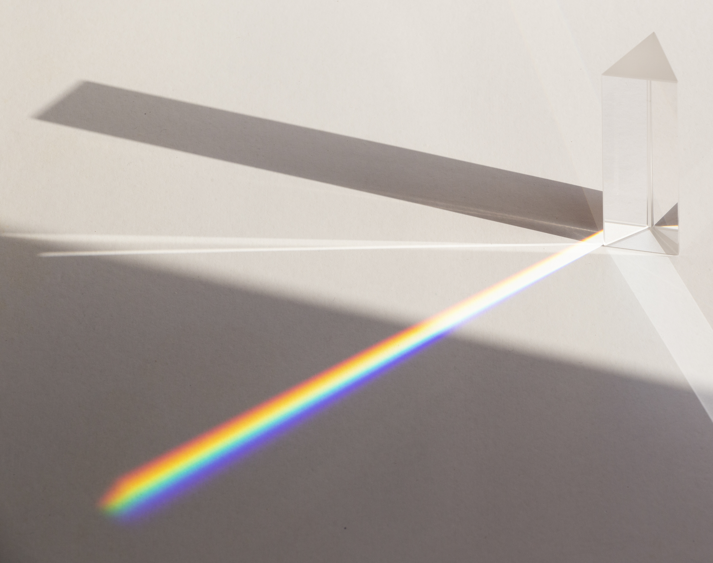
Zeeman effect
Physics Lab (Optics and Spectroscopy)
Autumn 2023(2023-1)

Slide 2
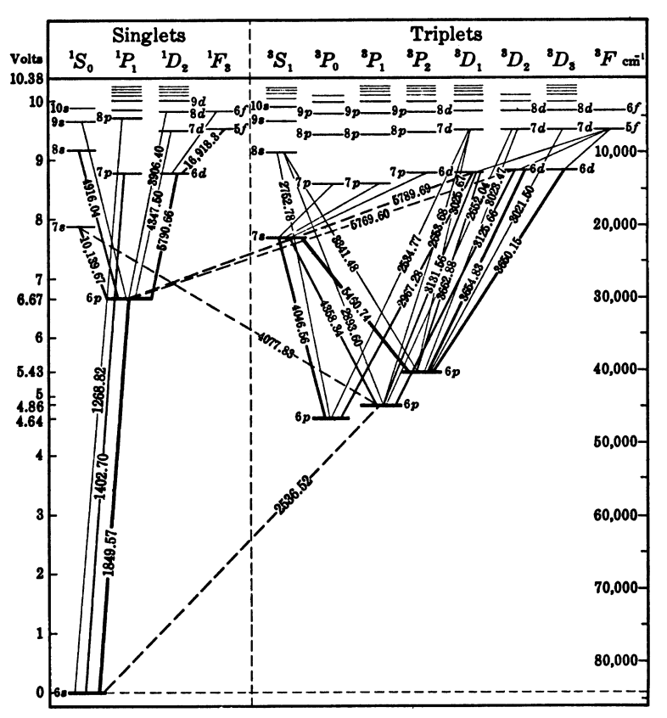
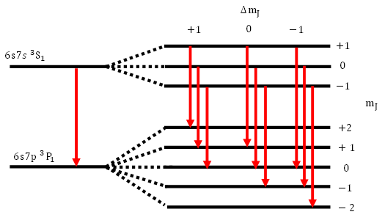

Introduction
Pieter Zeeman discovered in 1896 that emission lines of an atom split under external magnetic field
This effect is cause by splitting of energy levels of atom
Two energy levels of mercury
Before and after the magnetic field
One transition turns to multiple transition
Energy levels of mercury atom

Slide 3
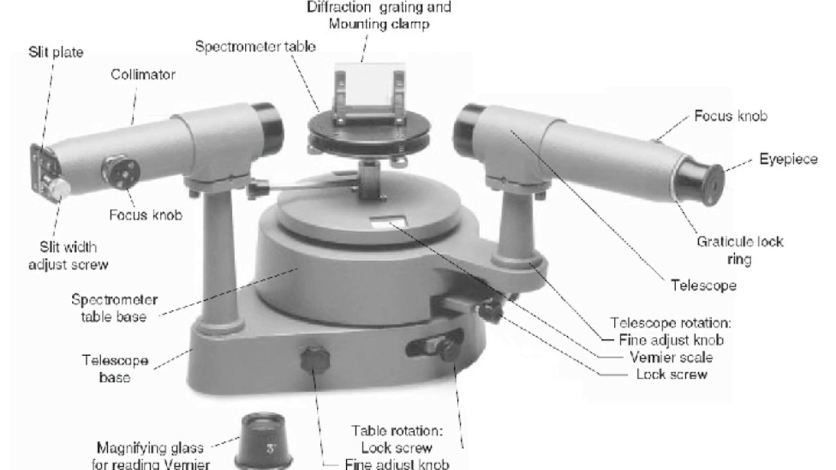
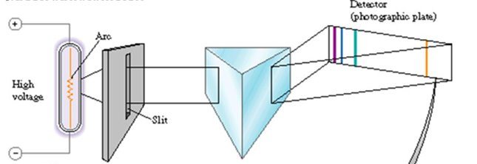
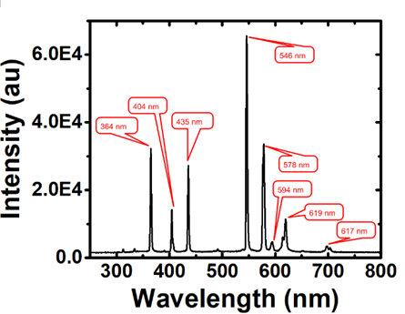
Atomic transitions are emission lines
Commonly used word is Zeeman effect is
Splitting of emission line
In grating spectrometer experiment, the spectrum of mercury atoms appeared as lines on screen.
Lines are just spectrally filtered image of slit
Emission lines are spectral peaks
In experiment, Zeeman effect is splitting of those emission lines

Slide 4

How does it happen?
Emission lines result due to transition of atom from higher energy level to lower energy level
The split in energy levels results in splitting or appearance of additional lines
Quantum mechanics makes the prediction about splitting of energy levels based on angular momentum of valance electrons and their interaction with external magnetic field
$∆E_{J}=g_{J}{\vec{μ}}_{B}.\vec{B}$
where ${\vec{u}}_{J}=g_{J}\frac{μ_{B}}{h}\vec{J}$
Before magnetic field
After magnetic field

Slide 5

What is the experiment?
To observe the Zeeman effect as the splitting of a mercury emission line
To verify the quantum theory by calculating the Bohr magneton using the Zeeman effect.
$${\vec{|μ}}_{B}|=\frac{hc\left(χ_{n+}^{2}− χ_{n−}^{2}\right)}{4{(g_{JH}+g_{JL})}_{J}λF^{2}|\vec{B}|}$$
To find the spacing between the reflecting plates Fabry-Perot etalon/interferometer.
Experiment is in three parts
1.Calibrate magnetic field
2.Estimate the spacing between mirrors of Fabry Perot interferometer
3. Estimate the Bohr magneton

Slide 6
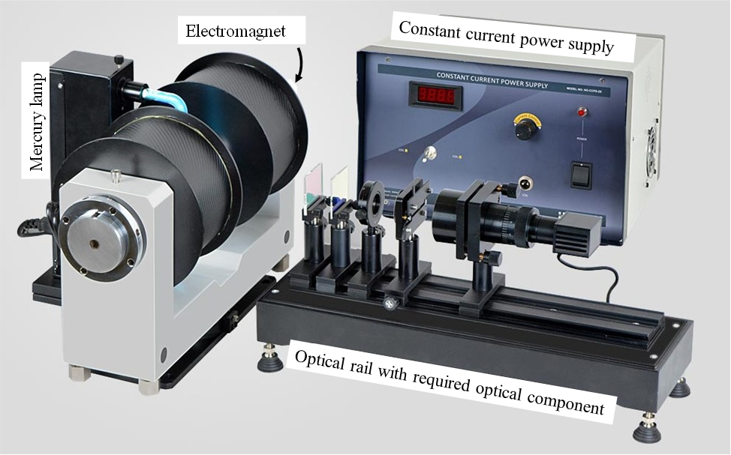
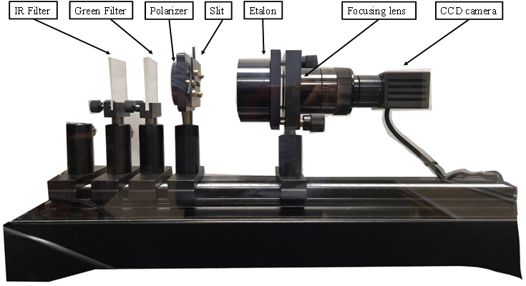
What to do?
Mercury lamp to provide emission lines i.e. transitions of atoms
Electromagnet to provide magnetic field
Optical assembly to measure splitting in energy of transition

Slide 7
Please read about
Zeeman Effect
Calculation of g factor from term symbols
Fabry Perot interferometer

